Slide 1
DA 507 modeling and optimization
Week 5
Stochastic Processes
Discrete Time Markov Chains
Kerem Bülbül & Güvenç Şahin

Slide 2
Stochastic Processes
Many processes evolve over time in a probabilistic manner.
  Stock price of a firm over time
  Market share of a firm over time
  Inventory level of a product over time
  Weather over time

Slide 3
Stochastic Processes
Two important types of such processes are
  Markov chains
  Queueing models
Let X_{t} be the value of a system characteristic at time t. If X_{t} is not known with certainty before time t, then X_{t} can be represented as a random variable – r.v.
The random variable X_{t} is referred to as the state of the system at time t.

Slide 4
Discrete Time
Stochastic Processes
If we observe X_{t} at discrete points in time, then the collection of random variables {X₀, X₁, X₂,..} is called a discrete time stochastic process.
  Stock price of a firm over time
    If the stock price is observed at the start of each trading session, then we have a discrete time stochastic process.
  Weather
    If the weather temperature is measured each morning, then we have a discrete time stochastic process.

Slide 5
Continuous Time
Stochastic Processes
If we may observe X_{t} at any point in time, then {X_{t}, t ¸ 0} is called a continuous time stochastic process.
  Stock price of a firm over time
    If the stock price is observed continuously throughout trading, then we have a continuous time stochastic process.
  Weather
    If the weather temperature is measured continuously, then we have a continuous time stochastic process.

Slide 6
State Space
Finite state space
  If X_{t} may only assume a finite number of values, then the stochastic process is said to have a finite state space.
    Inventory level of a product assuming that there is a storage capacity.
Infinite state space
  If X_{t} may take an infinite number of different values, then the stochastic process is said to have an infinite state space.
    Stock prices.
    Weather temperature.

Slide 7
Scope
We will discuss discrete time, finite state space Markov chains.
Continuous time, infinite state space stochastic processes are common in queueing theory.
We are interested in the mathematical modeling of stochastic processes which requires us to describe the relationships between the r.v.’s X₀, X₁, X₂,… or {X_{t}, t¸0}.

Slide 8
A Weather Example
Weather in Istanbul changes quickly from day to day.
If the weather is dry today, then it will be dry tomorrow with probability 0.8.
If it is raining today, then the weather will be dry tomorrow with probability 0.6.
Starting on some initial day (labeled as zero), the weather is observed on each day t=0,1,…

Slide 9
A Weather Example
Discrete or continuous time?
  Discrete
The state of the system
  State 0 = day is dry
  State 1 = it is raining
State space
  Finite

Slide 10
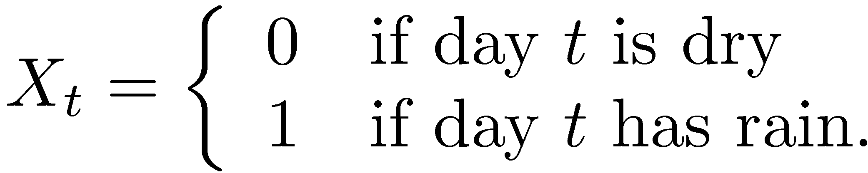
A Weather Example
Thus, for t=0,1,2,…, we have
The stochastic process {X₀, X₁, X₂, …} describes how the weather in Istanbul changes over time.

Slide 11
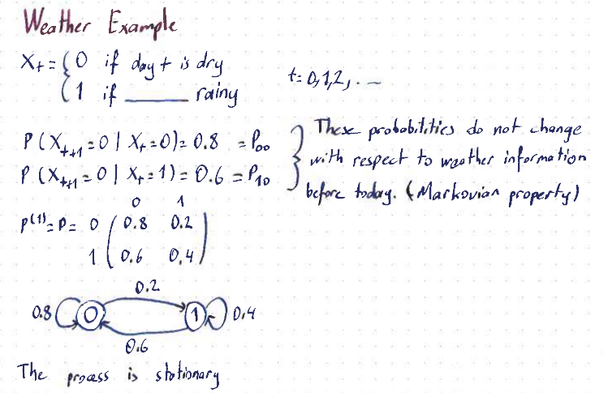

Slide 12
Gambler’s Ruin Problem
At t = 0, we have $2.
At times t = 1, 2, … we play a game in which we bet $1.
With probability p we win the game, and with probability 1-p we lose the game.
We quit the game if our capital is increased to $4 or reduced to $0.

Slide 13
Gambler’s Ruin Problem
What kind of a stochastic process?
  Discrete time, finite state space.
What if we keep playing unless we lose all of our capital?
  Discrete time, infinite state space.

Slide 14
Gambler’s Ruin Problem
State of the system
  X_{t} = capital on-hand at time t.
What is known about the state of the system?
  X₀ = 2 is a known constant
  X_{t} is a r.v. for all t ¸ 1.
  There is a probabilistic relationship between X_{t} and X_{t+1} 8 t¸ 0. For instance,
    P(X₁=1 / X₀=2) = 1- p
    P(X₁=3 / X₀=2) = p
    P(X_{t+1}=1 / X_{t} = 4) = 0
The stochastic process {X₀, X₁, X₂, …} describes how our capital changes over time.

Slide 15
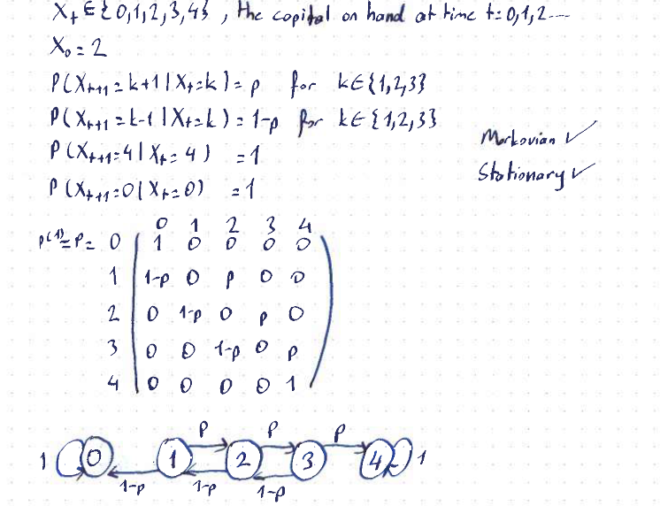

Slide 16
An Inventory Example
A camera store stocks a particular model to be ordered weekly.
Let D_{t} be the demand in week t. Note that D_{t} includes lost sales if there is no camera in stock.
Inventory management policy
  Each Saturday the owner places an order of 3 units if no camera is left in stock. Otherwise, no order is placed. Orders arrive on Monday morning before the store is opened.
We are interested in modeling the stock level of the store over time.

Slide 17
An Inventory Example
What kind of a stochastic process?
  Discrete time, finite state space.
State of the system
  X_{t} = inventory on-hand at the end of week t=0,1,…
  What are the possible states?
    0, 1, 2, 3 cameras on hand.

Slide 18
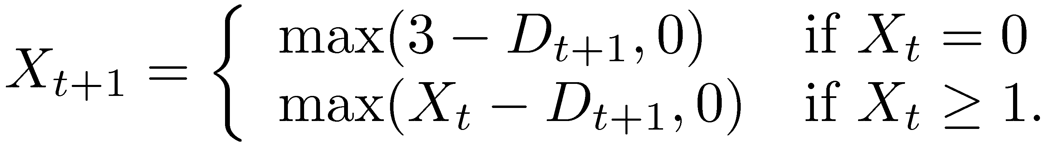
An Inventory Example
What is the relationship between X_{t}, X_{t+1} and D_{t+1}?
The stochastic process {X₀, X₁, X₂, …} describes how the inventory level of the store changes over time.

Slide 19
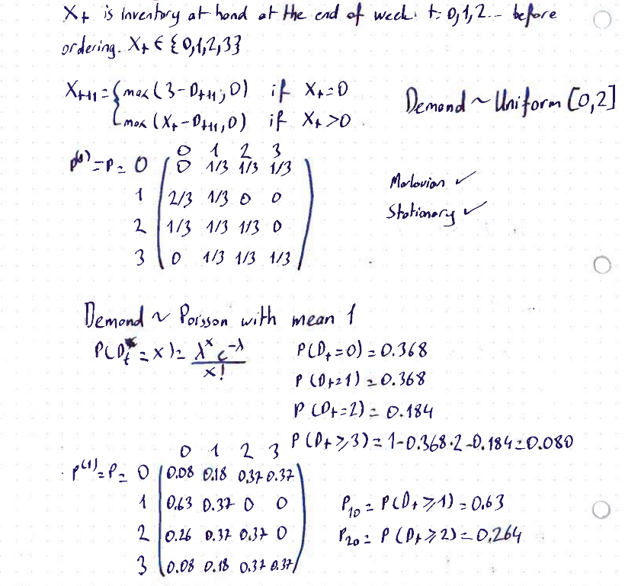
Burda önemli olan haftaosunudaki durumun modelini çıkarmak, haftabaşı dğeil, bideoda anlatmış detaylıca.
Talebin iki farklı dağılıma göre hesap yapmış hoca. Bi uniform olma durum ubir de poisson olma durumu

Slide 20
Markovian Property
In order to establish mathematical tractability of {X_{t}}, assumptions on the joint probability distribution of X₀, X₁, X₂,…, are necessary.
A discrete time stochastic process {X_{t}} is said to have the Markovian property if
P(X_{t+1}=j / X_{t} = i, X_{t-1}=k_{t-1}, X_{t-2}=k_{t-2}, …, X₀=k₀)
= P(X_{t+1}=j / X_{t} = i) 8 t=0,1,… and every sequence j,i,k_{t-1},k_{t-2},…,k₀.
In other words, the next state does only depend on the current state, and is independent from all past states. This holds for all points in time.

Slide 21
Markov Chain
A discrete time stochastic process with the Markovian property is called a discrete time Markov chain.
The conditional probabilities P(X_{t+1}=j / X_{t}=i) are called the one-step transition probabilities.
The conditional probabilities P(X_{t+n}=j / X_{t}=i) are called the n-step transition probabilities.

Slide 22
Stationarity
If, in addition, for each i and j,
P(X_{t+1}=j / X_{t}=i) = P(X₁=j / X₀=i) for all t=0,1,2,…, then we say that the (one-step) transition probabilities are stationary.
This also implies that for each i, j and n=0,1, 2,…
P(X_{t+n}=j / X_{t}=i) = P(X_{n}=j / X₀=i) for all t=0,1,2,….

Slide 23
Stationarity
Here, we assume that the transition probabilities are stationary. Let
P_{ij} = P(X_{t+1}=j / X_{t}=i) = P(X₁=j / X₀=i) and
P^{(n)}_{ij} = P(X_{t+n}=j / X_{t}=i) = P(X_{n}=j / X₀=i).
Thus, the n-step transition probability P^{(n)}_{ij} is the conditional probability that the system will be in state j after exactly n steps (time steps), given that it starts in state i at any time t.

Slide 24
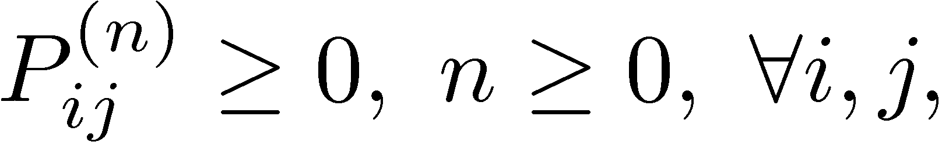
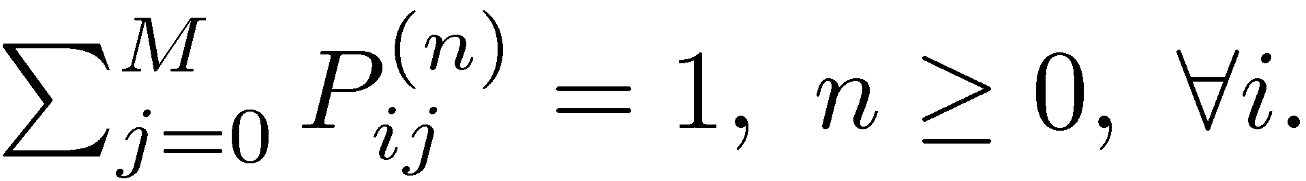
Transition Probabilities
Assuming that we have M+1 states labeled as 0,1,…M, we must have

Slide 25
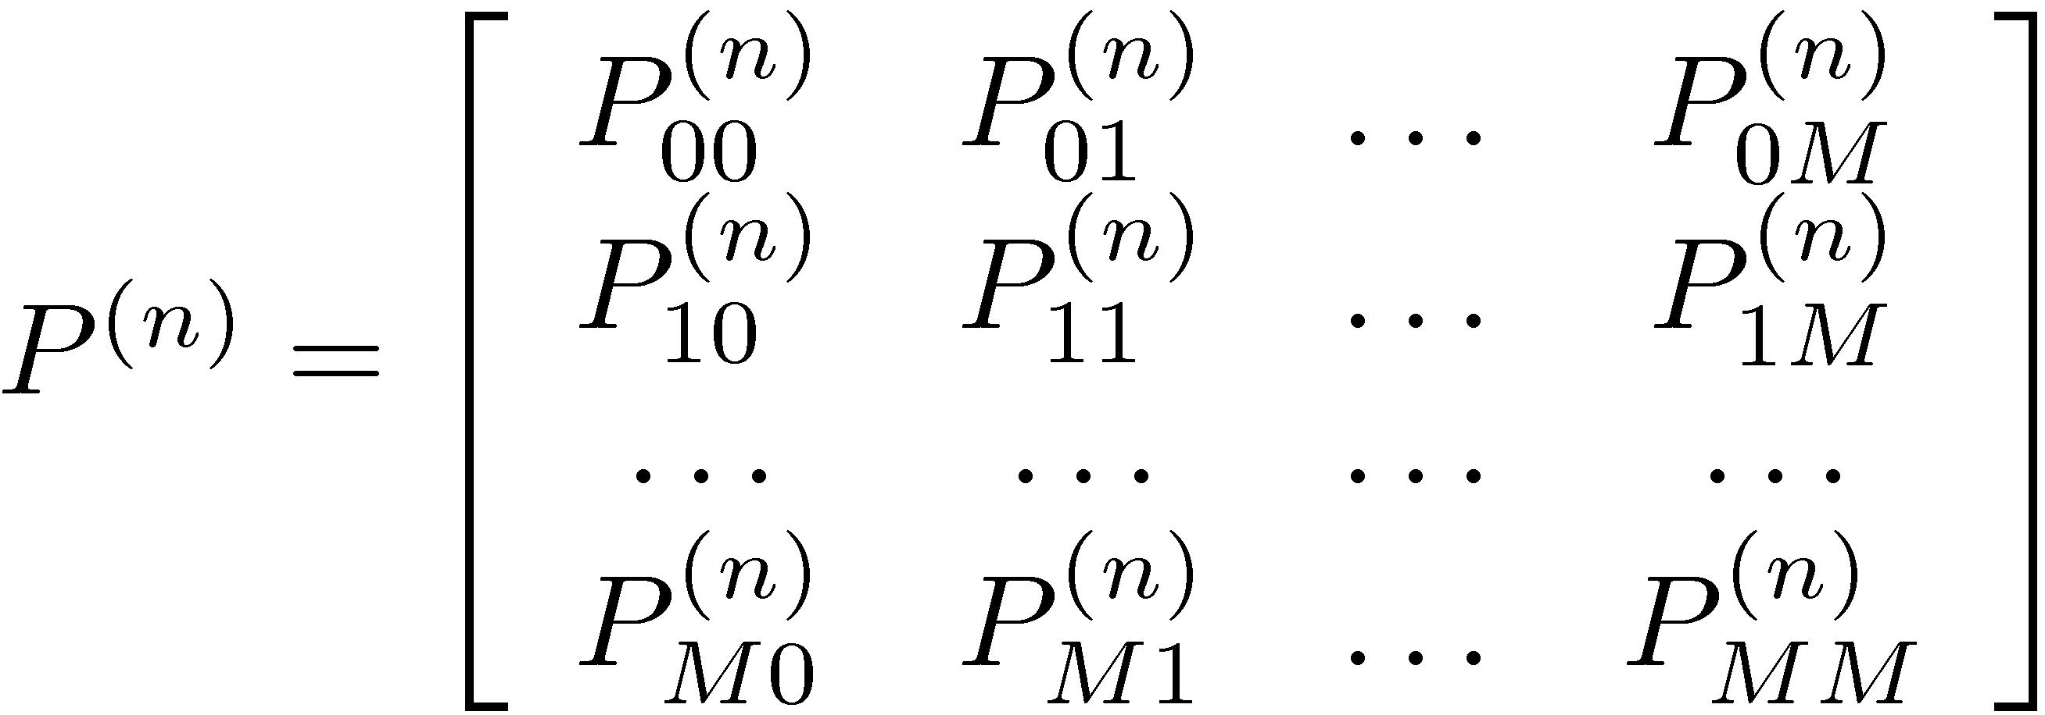
Transition Probabilities
The n-step transition probabilities are generally represented in a matrix format:
Transitions
from a state
Transitions to a state

Slide 26
Focus
Here, we will consider Markov chains with
  A finite number of states, and
  Stationary transition probabilities.
Furthermore, we assume that the initial probabilities P(X₀=i) are known for all states i.
We will mostly focus on discrete time Markov chains and will briefly touch upon continuous time Markov chains in the context of queueing systems.

Slide 27
Markov Chain Modeling
Examples
  Weather example
  Gambler’s ruin problem
  Inventory example

Slide 28
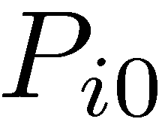
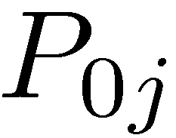
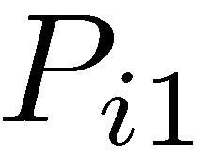
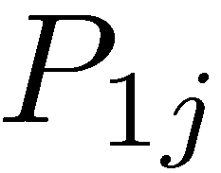
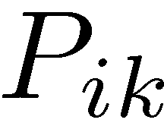
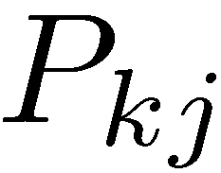
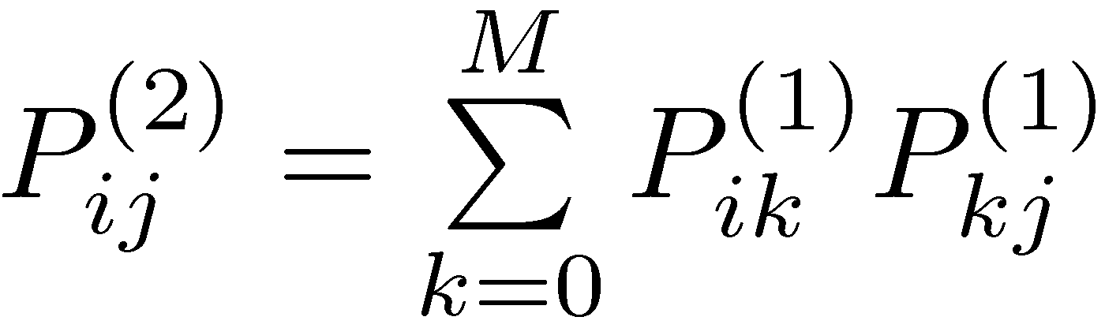
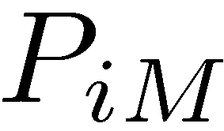
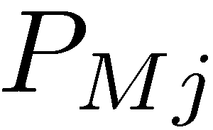
Computation of
Transition Probabilities
The following graph illustrates how we may compute the n-step transition probabilities.
0
1
So?
i
j
k
M
t = 0
t = 1
t = 2

Slide 29
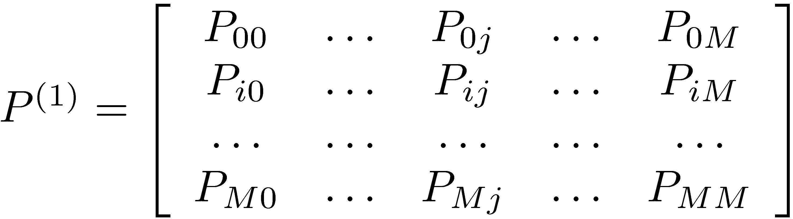
Computation of
Transition Probabilities
Row i
Column j
So, we conclude that P⁽²⁾_{ij} is the element (i,j) of P⁽²⁾ = P⁽¹⁾¢ P⁽¹⁾ = P¢ P = P²

Slide 30
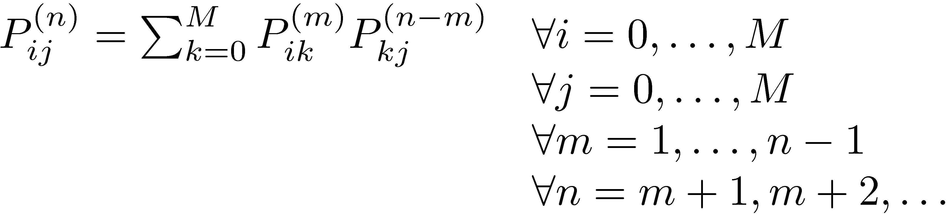
Computation of
Transition Probabilities
The generalization of this approach to the computation of the n-step transition probabilities results in the so-called Chapman-Kolmogorov equations.
Note that Pik^{(m)}¢ Pkj^{(n-m)} is the conditional probability that, starting in state i, the process goes to state k after m steps and then to state j in (n-m) steps.

Slide 31
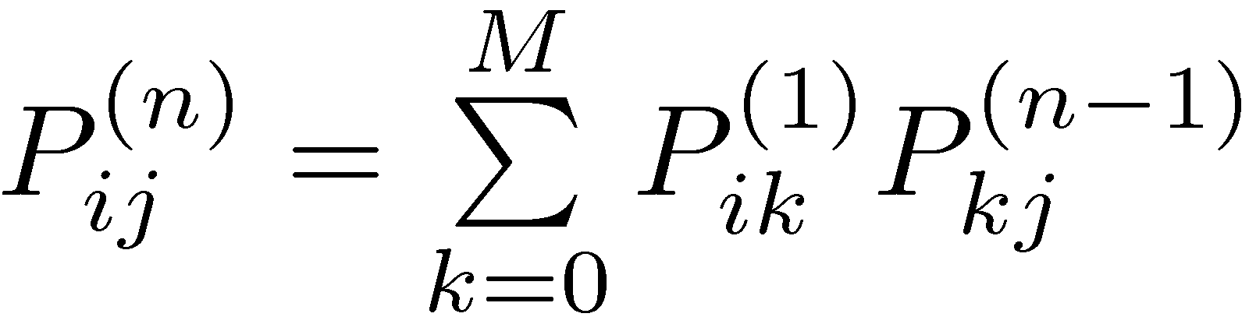
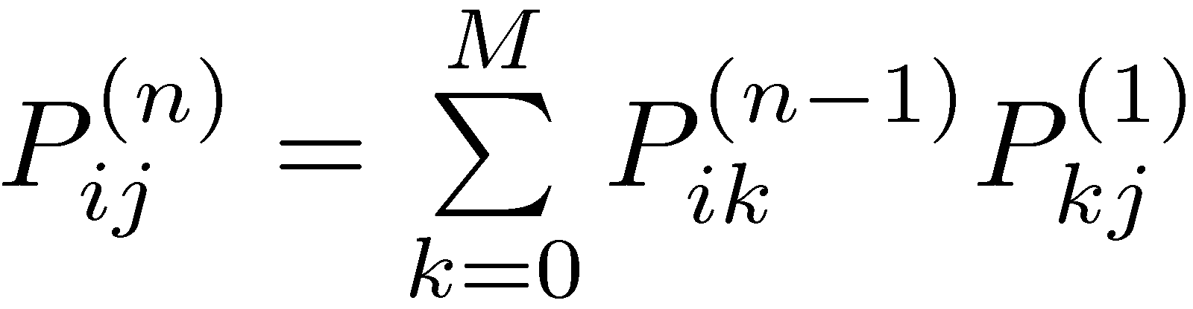
Computation of
Transition Probabilities
For the special cases of m=1 and m=n-1, we obtain
Using the equations above recursively:

Slide 32
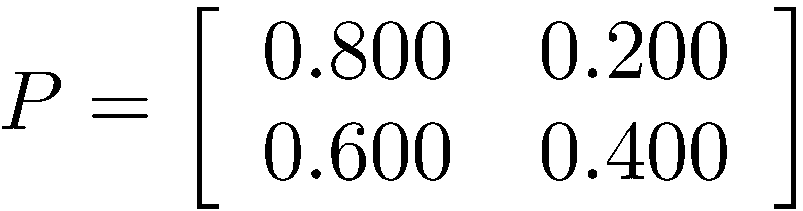
n-Step Transition Matrices for the Weather Example
Probability of rain two days from now if it is dry today.

Slide 33
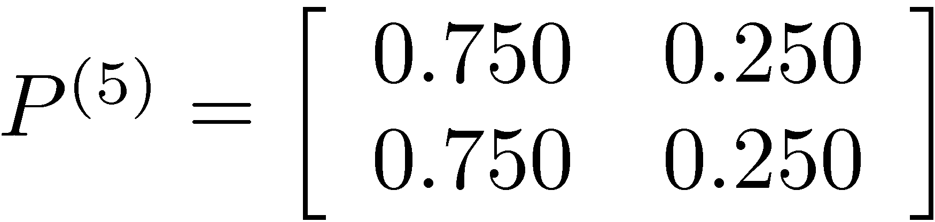
n-Step Transition Matrices for the Weather Example
What does P⁽⁵⁾ tell us?
  The probability of being dry five days from now is 0.75 regardless of whether it is dry today or not.
  The probability of rain five days from now is 0.25 regardless of whether it is raining today or not.
  These probabilities are the steady-state probabilities of this Markov Chain.

Slide 34
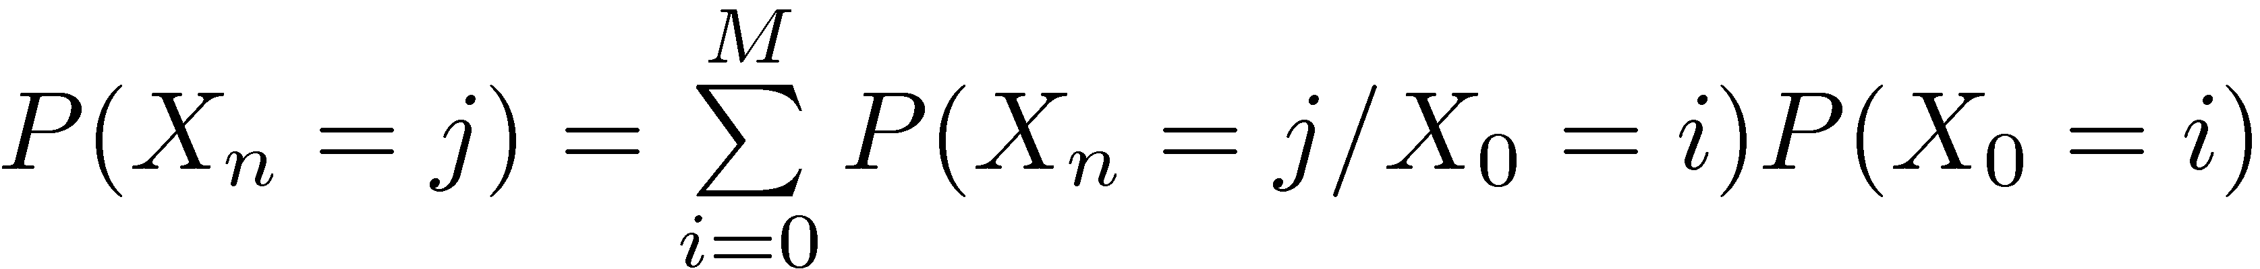
Unconditional State Probabilities
The n-step transition probabilities
P^{(n)}_{ij} = P(X_{n}=j / X₀=i) are conditional probabilities.
If we need the unconditional probability of being in state j after n steps, i.e., P(X_{n} = j), then we need to compute

Slide 35
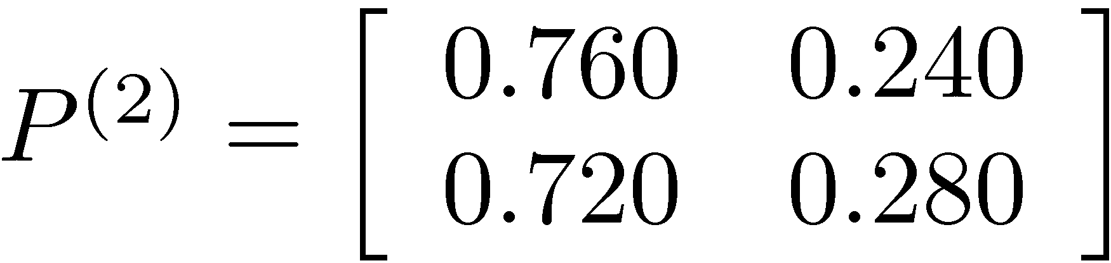
Unconditional State Probabilities for the Weather Example
Assume that it rained 131 days last year. What is the probability of rain two days from now?
Hence,
P(rain two days from now)
= (365-131)/365 * 0.240 + 131/365 * 0.280 = 0.254.

Slide 36
Unconditional State Probabilities for the Weather Example
Let q_{i} be the probability of being in state i at time 0, and let q be a row vector of these initial probabilities. Then, q ¢ P^{(n)}_{.j} yields the probability of being in state j after n steps, where P^{(n)}_{.j} is the j^{th} column of P^{(n)}.
For the weather example:
Probability of being dry two days from now
Probability of rain two days from now

Slide 37
An Investment Example
An investor buys shares of a stock at 38 TL.
He gives orders to his broker to sell the stock as soon as its price rises to 40 TL or above or falls to 37 TL or below.
From observing this stock over the last few weeks, the investor estimates that the probability of a price rise of 1 TL is 0.5 and that the probability of a price decline of 1 TL is 0.2 for each day.

Slide 38
An Investment Example
What is the probability that the broker sells the stock within 4 days?
Only for this part of the problem, assume that the investor has to sell the stock within 4 days. In other words, either the selling conditions are met and the stock is sold within 4 days, or the selling conditions are not met within 4 days, and the stock is sold at the current price at the end of the 4th day. What is the expected net loss/gain per share at the end of the 4th day?

Slide 39
Classification of States in a
Markov Chain
Given two states i and j, a path from i to j is a sequence of transitions that begins at i and ends at j such that each transition in the sequence has a positive probability of occurring.
State j is said to be accessible from state i if P_{ij}^{(n)} > 0 for some n ¸ 0.
  A path exists from i to j.
  It is possible for the system to eventually enter state j starting from state i.

Slide 40
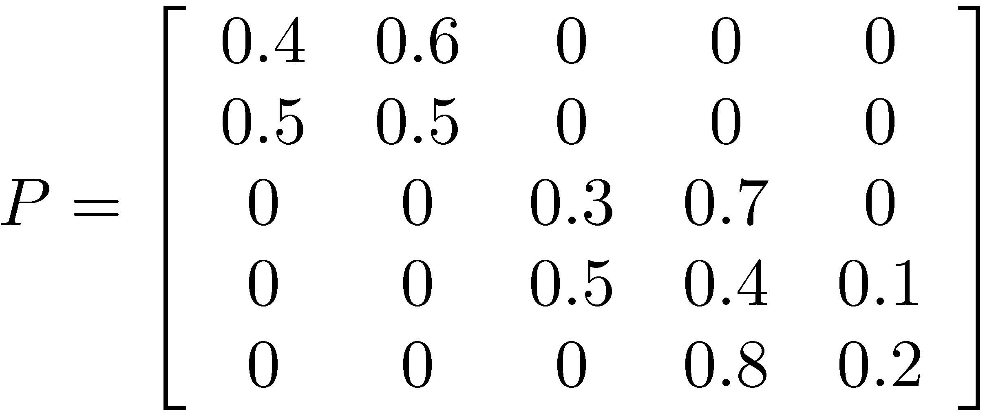
Example
0.4
0.6
0.3
0.7
0.5
0.4
1
2
3
4
0.8
0.5
0.5
0.2
0.1
5

Slide 41
Gambler’s Ruin Problem
p
p
p
1
1
0
1
2
3
4
1-p
1-p
1-p
1 and 2
  1 is accessible from 2 and vice versa.
1 and 3
  1 is accessible from 3 and vice versa.
0 and 3
  0 is accessible from 3, but not vice versa.
0 and 4
  0 is not accessible from 4 and vice versa.

Slide 42
Communication
If state j is accessible from state i, and state i is accessible from state j, then states i and j are said to communicate.
  Any state communicates with itself.
    P_{ii}⁽⁰⁾=P(X₀=i / X₀=i) = 1.
  If state i communicates with state j, then state j communicates with state i.
  If state i communicates with state j, and state j communicates with state k, then state i communicates with state k.

Slide 43
Communication
Communication partitions the states into disjoint classes.
  A class may be a single state.
If there is only one class, i.e., if all states communicate, then the Markov chain is said to be irreducible.

Slide 44
Example
0.4
0.6
0.3
0.7
0.5
0.4
1
2
3
4
0.8
0.5
0.5
0.2
0.1
5
Irreducible?
  No. There are two classes.

Slide 45
Gambler’s Ruin Problem
p
p
p
1
1
0
1
2
3
4
1-p
1-p
1-p
Irreducible?
  No.
How many classes?
  3.
What are the classes?
  {0}
  {1,2,3}
  {4}

Slide 46
Transient States
A state is said to be transient if, upon entering this state, the process may never return to this state again.
  Therefore, state i is transient if and only if there exists a state j accessible from i, but not vice versa.
    Recall gambler’s ruin problem.
  Since there is a positive probability that the process will never return to a transient state,
    a transient state will be visited only a finite number of times.

Slide 47
Recurrent States
A state is said to be recurrent if, upon entering this state, the process will definitely return to this state again.
  Thus, a recurrent state will be visited infinitely many times if it is entered once.
A state is said to be absorbing if, upon entering this state, the process will never leave this state. Thus, for an absorbing state i
  P_{ii} = 1.
Notes:
Note that an absorbing state is also a recurrent state.

Slide 48
Transient and Recurrent States
0.4
0.6
0.3
0.7
0.5
0.4
1
2
3
4
0.8
0.5
0.5
0.2
0.1
5
Transient states?
  None.
Recurrent states
  All.
Absorbing states?
  None.

Slide 49
Transient and Recurrent States
1
1
0
1
2
3
4
1-p
1-p
1-p
Transient states?
  {1,2,3}.
Recurrent states
  {0} and {4}.
Absorbing states?
  {0} and {4}.
Notes:
So, emphasize that an absorbing state is a special type of recurrent state.

Slide 50
Transient and Recurrent States
Recurrence is a class property.
  That is all states in a class are either recurrent or transient.
In a finite-state Markov chain, not all states can be transient. Why?
Therefore, in a finite-state, irreducible Markov chain
  all states must be recurrent.
Notes:
If all states are transient, after a finite time T = max{T_0, T_1, …, T_M} no state will be visited. However, the process must be in some state after time T, and we arrive at a contradiction.

Slide 51
Periodicity
The period t>1 of a state i is defined as the largest integer such that P^{(n)}_{ii} = 0 when n is not divisible by t.
If there are two consecutive numbers s and s+1 such that the process can be in state i at times s and s+1 starting at state i, then the state is said to have period 1 and is called aperiodic.
Notes:
Note that the statement does not require P^{(n)}_{ii} to be positive when n is divisible by t. Therefore, we need the largest integer with such property.

Slide 52
Periodicity
0.4
0.6
0.5
1
2
0.5
What is the period of 1?
  Aperiodic.
What is the period of 2?
  Aperiodic.

Slide 53
Periodicity
1
1
0
1
2
3
4
1-p
1-p
1-p
What are the periods of 0 and 4?
  Aperiodic.
What is the period of 1?
  2.
What is the period of 2?
  2.
What is the period of 3?
  2.

Slide 54
Periodicity
Periodicity is a class property.
  That is, if state i in a class has period t, then all states in that class have period t.

Slide 55
Ergodicity
In a finite-state Markov chain, recurrent states that are aperiodic are called ergodic.
A Markov chain is said to be ergodic if all states are ergodic.
This is a key property for the existence of steady-state probabilities.

Slide 56
Limiting Probabilities
Recall the weather example.
If n is large enough, the probability that the system is in a particular state after n transitions does not depend on the initial state.

Slide 57
Limiting Probabilities
We will investigate the long term properties of Markov Chains.
  Under which conditions does P^{(n)} converge?
  Interpretations of limiting probabilities.
  Is there an efficient way of computing the limiting probabilities when they exist?

Slide 58
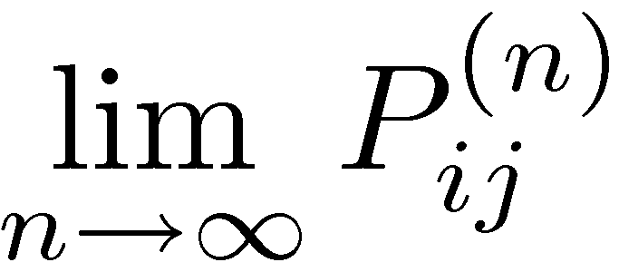
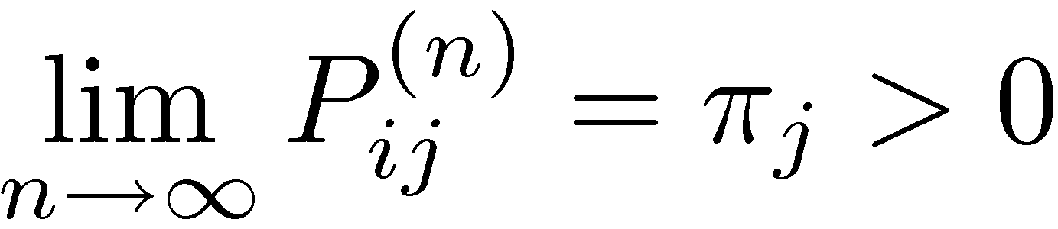
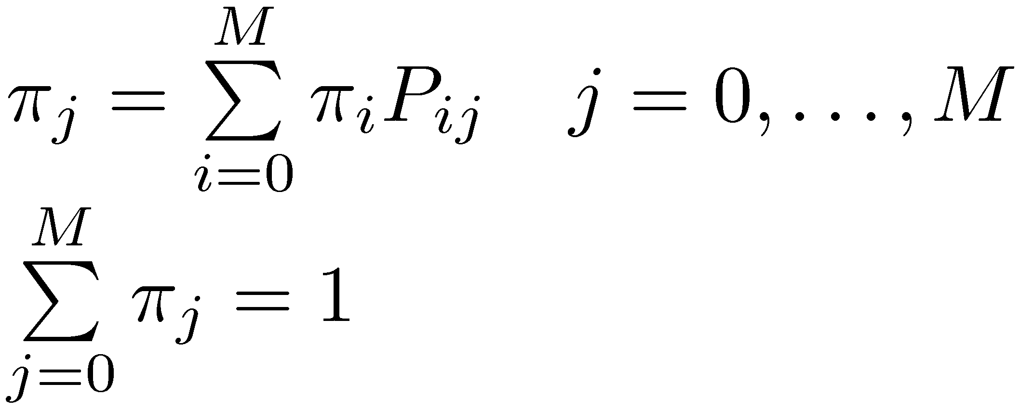
Limiting Probabilities
For any irreducible ergodic finite-state Markov chain, exists and is independent of i. Furthermore,
where π_{j}’s uniquely satisfy the following steady-state equations:
Notes:
The theorem can be extended to any irreducible ergodic Markov chain if we allow the limiting probabilities to be zero.

Slide 59
Interpretation of
Limiting Probabilities
Steady-state probabilities
  The probability of finding the process in a certain state, say j, after a large number of transitions converges to the value π_{j}, independent of the distribution of the initial state.
  Note that this does not mean that the Markov chain settles into a state. The process continues to make transitions according to the one-step transition probability matrix.

Slide 60
Interpretation of
Limiting Probabilities
Steady-state probabilities
  Equivalently, we can state that the long-run proportion of time that the process will be in state j is π_{j}.

Slide 61
Interpretation of
Limiting Probabilities
Stationary probabilities
  These are not to be confused with the stationary transition probabilities.
  If P(X₀ = j) = π_{j} 8 j, then the probability of finding the process in state j after n=1,2,… transitions is also π_{j}. In other words,
  P(X₁ = j) = π_{j} 8 j, P(X₂ = j) = π_{j} 8 j, etc.

Slide 62
Interpretation of
Limiting Probabilities
Equilibrium distribution.
j
Probability of entering state j
Probability of leaving state j
What do you expect?
  These probabilities are equal in steady state.

Slide 63
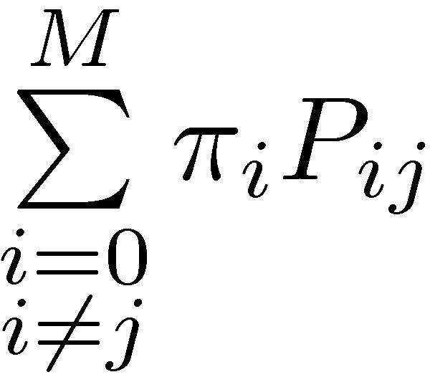
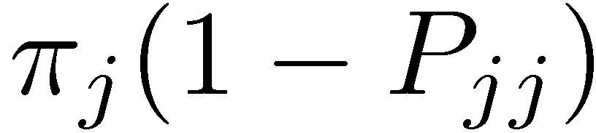
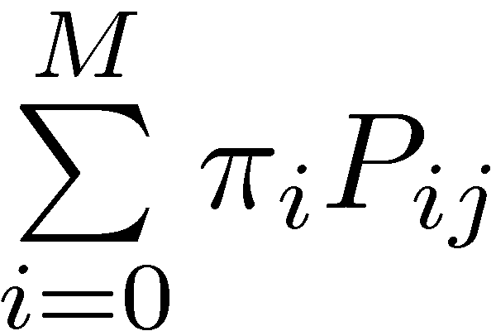
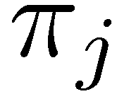
Interpretation of
Limiting Probabilities
Equilibrium distribution.
Probability of entering state j
=
Probability of leaving state j
j
=
(1)
=
If (1) were violated for any state, then for some state j, the LHS of (1) would exceed the RHS of (1).
This would result in probability “piling up” in state j, and the steady state distribution would not exist.

Slide 64
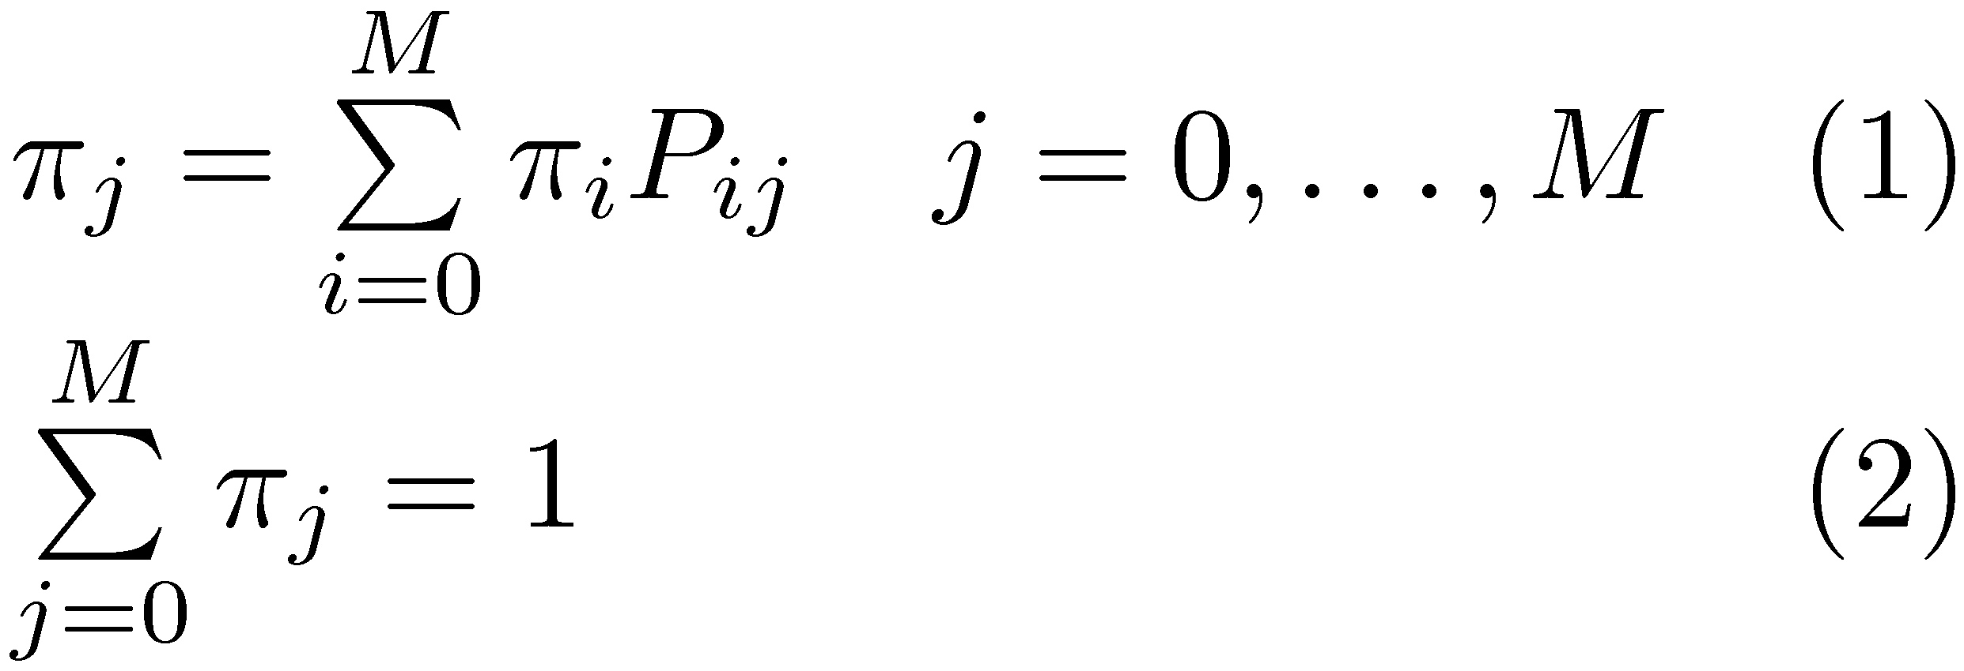
Computing Limiting Probabilities
How many variables do we have?
  M+1
How many equations do we have?
  M+2
So, how do we find a unique set of π_{j}’s that satisfy the equations above?

Slide 65
Computing Limiting Probabilities
Since there is a unique solution, one of the constraints in (1) must be redundant.
  Note the π_{j} = 0 8 j satisfies the M+1 equations given in (1).
  If this were the unique solution, then (2) would not hold. Hence,
    One of the constraints in (1) must be redundant and can be omitted while solving for π_{j}’s.

Slide 66
Computing Limiting Probabilities
Example…

Slide 67
Conditions for Limiting Probabilities Revisited
Recall that we require an irreducible ergodic Markov chain for computing the limiting probabilities. What if we have more than one recurrent and aperiodic class?
0.3
0.7
0.4
0.4
0.6
0.5
3
4
0.8
1
2
0.5
0.5
0.2
0.1
5
Notes:
Here, the limiting probabilities are not independent of the initial state.

Slide 68
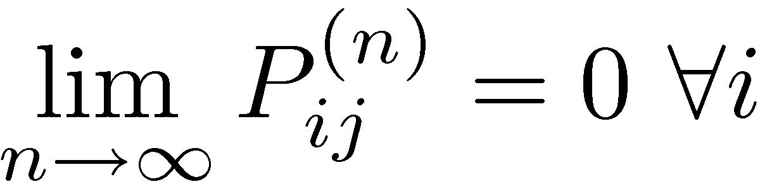
Conditions for Limiting Probabilities Revisited
What if j is a transient state?
What are the limiting probabilities for:
0.3
0.7
0.4
0.4
0.6
0.4
3
4
0.8
1
2
0.5
0.5
0.1
0.2
0.1
5
Notes:
There is one aperiodic, transient and one aperiodic, recurrent class.
0 for the transient class. Find the limiting probabilities for the recurrent class as if it were the only class.

Slide 69
Conditions for Limiting Probabilities Revisited
What if the states are not aperiodic? Then,
does not exist. Consider
1
1
2
1
If the process starts at 1, then it will be in state 1 at times 0,2,4,…, and in state 2 at times 1,3,5,…

Slide 70
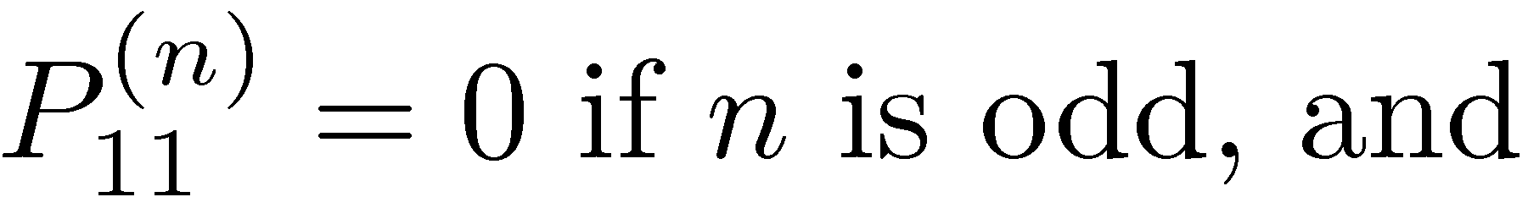
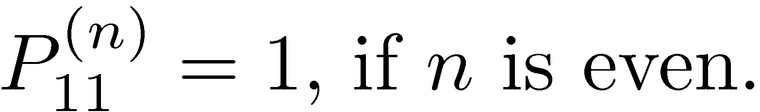
Conditions for Limiting Probabilities Revisited

Slide 71
Conditions for Limiting Probabilities Revisited
In this case, i.e., when a finite-state Markov chain is irreducible but has a period t > 1, π_{j} > 0 8 j is still the unique solution of
However, now πj can be interpreted only as the long-run proportion of time the process spends in state j.

Slide 72
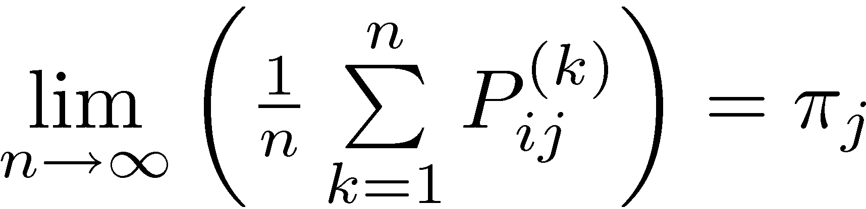
Expected Average Cost per
Unit Time
The following limit does always exist for an irreducible finite-state Markov chain:
Suppose that a cost (or another penalty or reward) C(X_{t}) is incurred when the process is in state X_{t} at time t=0,1,…
Assume that C(X_{t}) is independent of time and note that it is a random variable that takes on the values C(0), C(1),…,C(M).

Slide 73
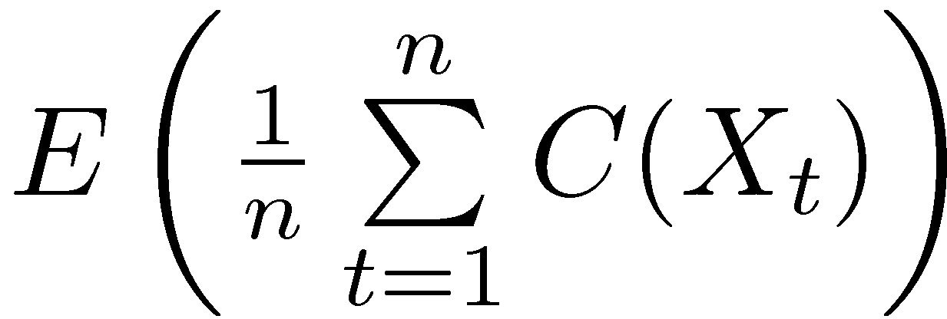
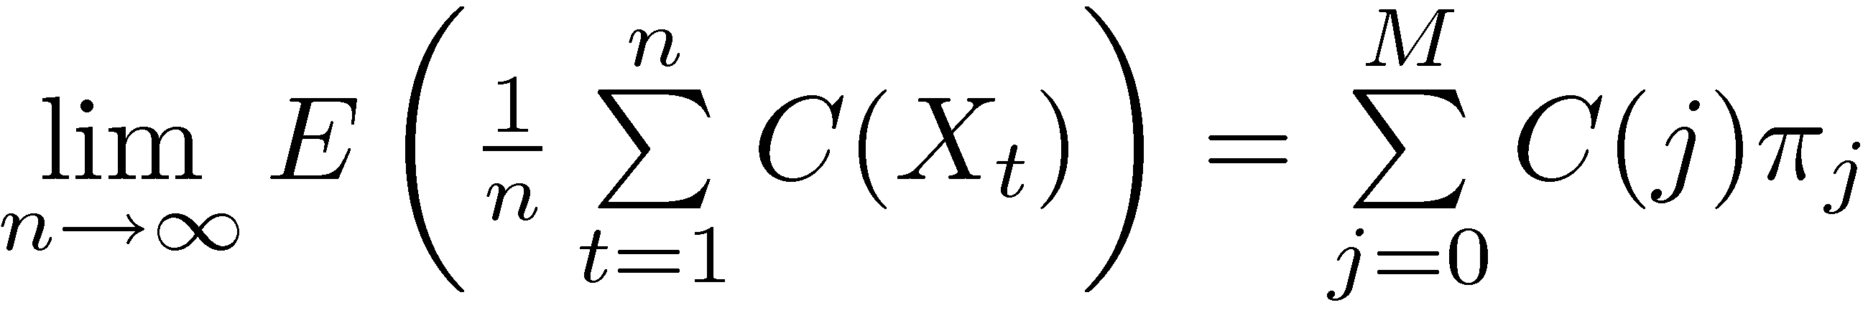
Expected Average Cost per
Unit Time
The expected average cost over the first n periods is given by:
Then, by using ,
we can show that

Slide 74
Expected Average Cost per
Unit Time
Assume that you receive $1 each time you visit state k. What is your long-run expected average reward per unit time?
  This is equivalent to determining the long-run expected fraction of time the system spends in state k.
  = π_{k}

Slide 75
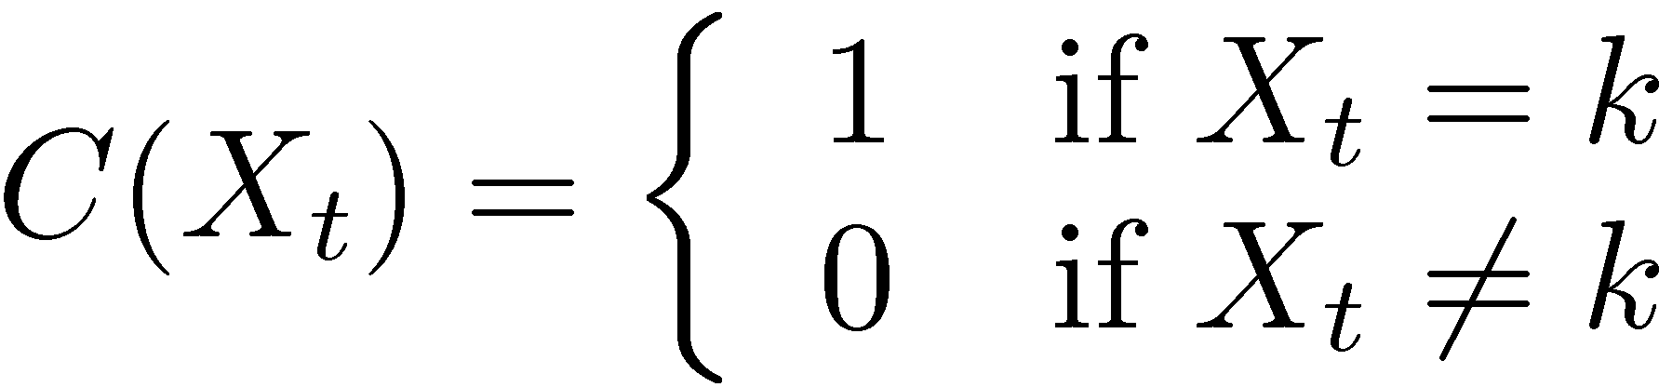
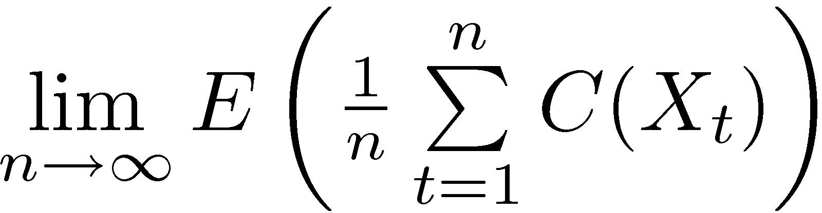
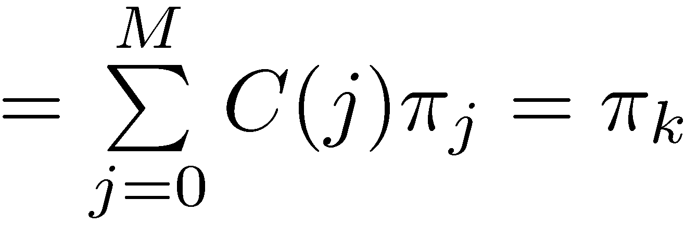
Expected Average Cost per
Unit Time
Define
Then,

Slide 76
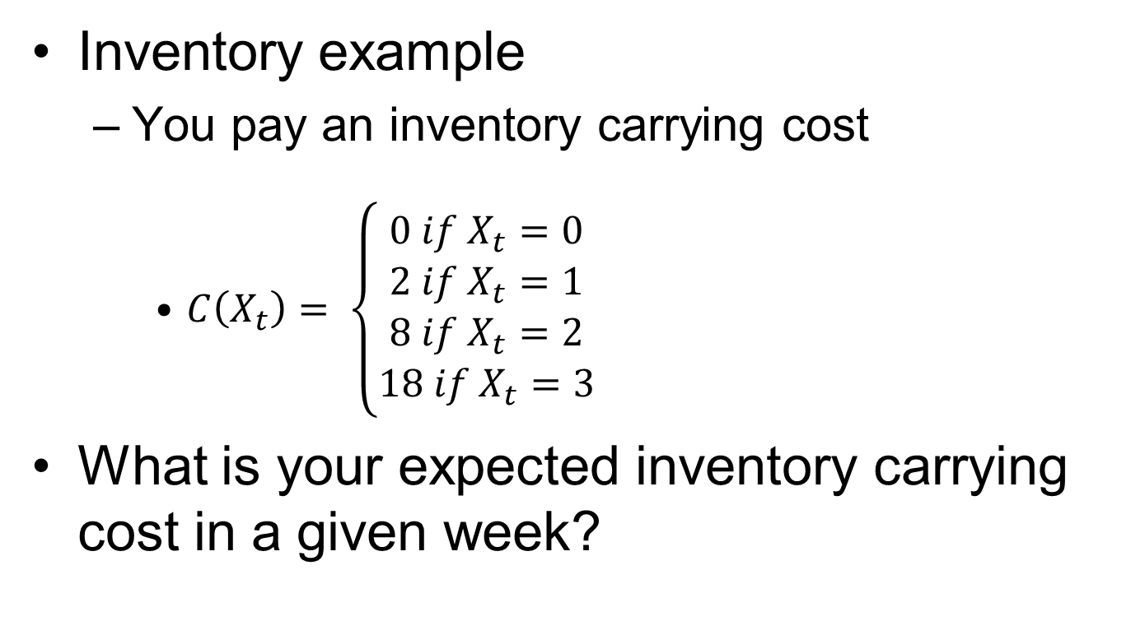
Expected Average Cost per
Unit Time
Inventory example
  You pay an inventory carrying cost
    $C\left(X_{t}\right)= \left\{\begin{matrix}0 if X_{t}=0 \\ 2 if X_{t}=1 \\ 8 if X_{t}=2 \\ 18 if X_{t}=3\end{matrix}\right.$
What is your expected inventory carrying cost in a given week?

Slide 77
Expected Average Cost per
Unit Time
Examples
  Inventory example
  Car replacement example

